Slide 1



WORD QUEST: Enhancing Vocabulary through Interactive Gameplay
Ubaub, Edilmar B.
Galanque, Jean Ira
Sabuero, Kerah
Guibone, Lady Jean
Guardiario, Diane Angel

Slide 2

INTRODUCTION
Gamified e-learning combines the principles of gaming with educational content to create an engaging and interactive lear experience. By using elements that captivate attention and motivate learners, it enhances participation, understanding, an retention. This innovative approach makes learning enjoyable fosters a deeper connection between students and the materi creating a more dynamic educational environment.

Slide 3
Objectives
The objective of gamified e-learning is to enhance the learning experience by fostering engagement, motivation, and active participation. It aims to create an interactive environment where learners can develop knowledge and skills effectively while enjoying the process. By integrating game-inspired strategies, this approach seeks to improve knowledge retention, promote continuous learning, and make education more accessible and enjoyable for diverse learners.

Slide 4
Scope and Delimitation
Scope:
Gamified e-learning focuses on integrating game-• like elements into digital educational platforms to enhance learner engagement, motivation, and knowledge retention. It is applicable to various fields, including academic institutions, corporate training, and personal development.
Delimitation:
The study or implementation of gamified e-learning is limited to offline platforms and may not address challenges requiring real-time updates or online collaboration. It relies on preinstalled software or localized systems, which may
limit content updates and accessibility for diverse subjects. Additionally, its effectiveness depends on the quality of the gamified design and the relevance of the content, which may vary across different learner preferences.

Slide 5
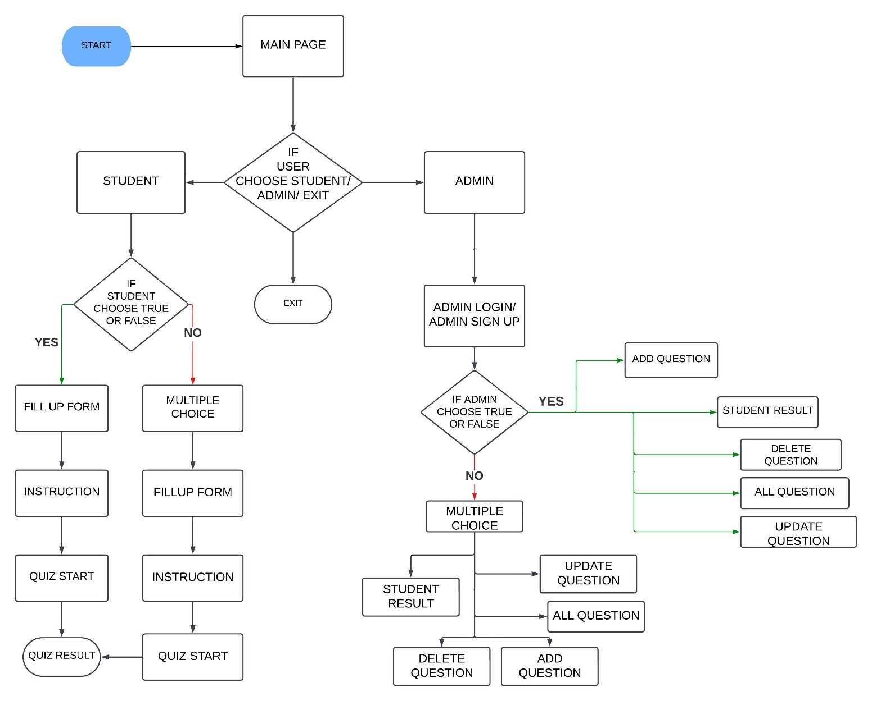
FLOWCHART

Slide 6
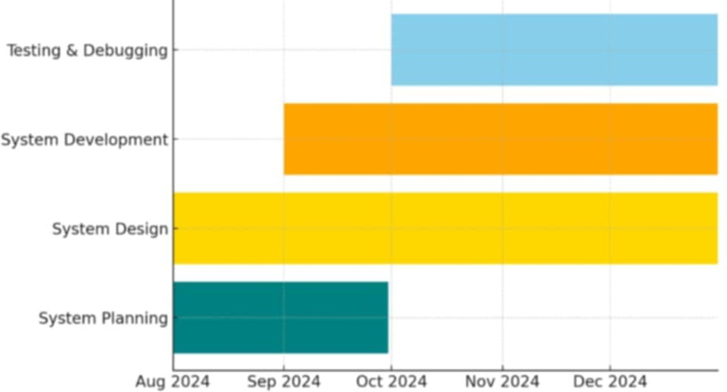
GANTT CHART

Slide 7
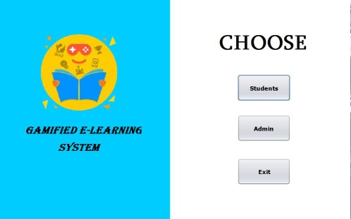
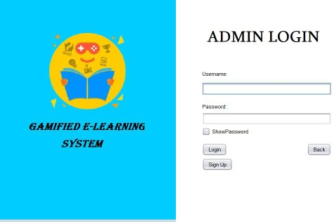
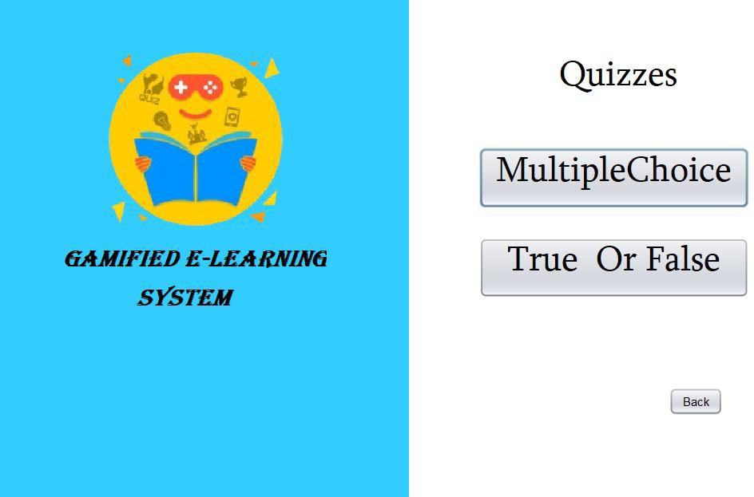
SYSTEM DESIGN
Fig 1.
Menu page for the student and admin to choose.
Fig 2.
If you click the admin button the admin login will appear.
Fig 3.
If the admin got Login in the system, the admin will choose a question type.

Slide 8
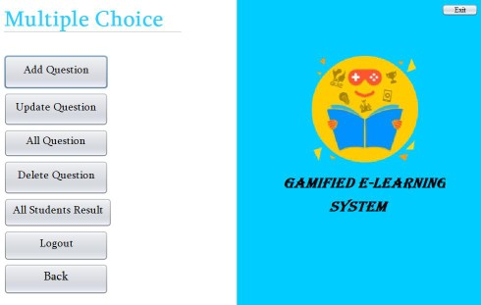
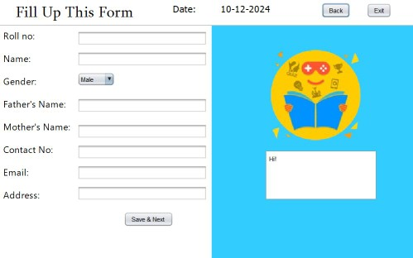
SYSTEM DESIGN
Fig 4.
After choosing a type of question in the fig 3, this will appear where you can create/add question, update question, delete question, and check the student result.
Fig 5.
Menu page for the student and admin to choose.
Fig 6.
If the user choose student, the fill up form will appear.

Slide 9
CONCLUSION
Gamified e-learning can make learning more engaging and fun, helping students stay motivated and retain information better. While it works well on offline platforms, its success depends on the quality of the content, design, and accessibility. Despite some challenges, it offers a valuable way to improve learning experiences.

Slide 10
RECOMMENDATION
To improve gamified e-learning on offline platforms, focus on creating engaging and easy-to-use systems with quality content. Ensure it is accessible to all learners, especially in areas with limited resources, and gather feedback to make regular updates and improvements.

